Slide 1
Automatic Gain Tuning
based on
Gaussian Process Global Optimization
(= Bayesian Optimization)
https://is.tuebingen.mpg.de/publications/marco_icra_2016

Slide 2
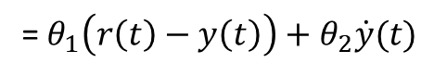
A simple PD control example
Global optimal gains, θ to get a minimum cost J ?
J
=${ θ}_{1}\left(r\left(t\right)−y\left(t\right)\right)+θ_{2}\dot{y}(t)$

Slide 3
A simple PD control example
Procedure of Bayesian Optimization
1. GP prior before observing any data
3. The next parameters θnext are chosen at the maximum of Acquisition function
2. GP posterior, after five noisy evaluations
Repeat until you can find
a globally optimal θ

Slide 4
Acquisition function
argmin

Slide 5
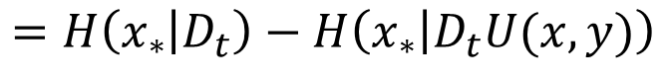
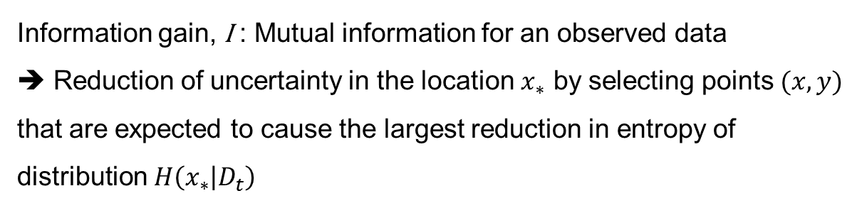
Acquisition function and Entropy Search
$$=H\left(x_{∗} | D_{t}\right)−H\left(x_{∗} | D_{t}U(x,y)\right)$$
Information gain, I : Mutual information for an observed data
➔ Reduction of uncertainty in the location $x_{∗}$ by selecting points $(x,y)$ that are expected to cause the largest reduction in entropy of distribution $H\left(x_{∗} | D_{t}\right)$

Slide 6
Control design problem
propose the use of Entropy Search, a recent algorithm for global Bayesian optimization, as the minimizer for the LQR tuning problem.
ES employs a Gaussian process (GP) as a non-parametric model capturing the knowledge about the unknown cost function.
consider a system that follows a discrete-time nonlinear dynamic model
system states xk, control input uk, and zero-mean process noise wk at time instant k

Slide 7
Control design problem
common way to measure the performance of a control system is through a quadratic cost function such as
cost captures a trade-off between control performance (keeping xk small) and control effort(keeping uk small)
Nonlinear control design problem is intractable in general.
linear model is often sufficient for control design

Slide 8
LQR tuning problem
Linear Quadratic Regulator (LQR)
static gain matrix F can readily be computed by solving the discrete-time infinite-horizon LQR problem for the nominal model (An, Bn) and the weights (Q, R).
goal of the automatic LQR tuning is to vary the parameters θ such as to minimize the cost

Slide 9
Optimization problem
Consider the approximate one of quadratic cost function

Slide 10
LQR TUNING WITH ENTROPY SEARCH
uncertainty over the objective function J is represented by a probability measure p(J), typically a Gaussian process (GP)
prior knowledge about the cost function J as the GP
with mean function $μ(θ)$and covariance function $k(θ,θ_{∗})$
squared exponential (SE) covariance function

Slide 11
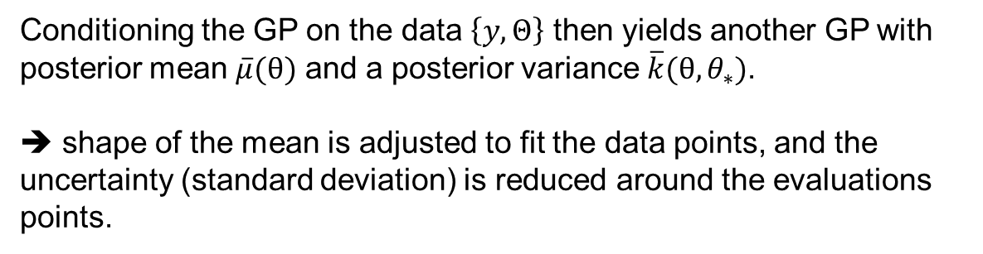
LQR TUNING WITH ENTROPY SEARCH
noisy evaluations of cost function can be modeled as
Conditioning the GP on the data $\left\{y, Θ\right\}$ then yields another GP with posterior mean $\overline{μ}(θ)$ and a posterior variance $\overline{k}(θ, θ_{∗})$.
➔ shape of the mean is adjusted to fit the data points, and the uncertainty (standard deviation) is reduced around the evaluations points.

Slide 12
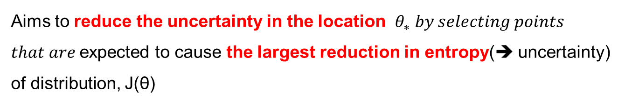
LQR TUNING WITH ENTROPY SEARCH
ES is one out of several popular formulations of Bayesian Optimization
Aims to reduce the uncertainty in the location $θ_{∗} by selecting points$
$that are$expected to cause the largest reduction in entropy(➔ uncertainty) of distribution, J(θ)

Slide 13
Bayesian Optimization
Bayesian Optimization and How to Scale It Up
Zi Wang
CS Colloquium, US

Slide 19
argmin

Slide 20
$$=H\left(x_{∗} | D_{t}\right)−H\left(x_{∗} | D_{t}U(x,y)\right)$$
Information gain, I : Mutual information for an observed data
➔ Reduction of uncertainty in the location $x_{∗}$ by selecting points $(x,y)$ that are expected to cause the largest reduction in entropy of distribution $H\left(x_{∗} | D_{t}\right)$

Slide 21
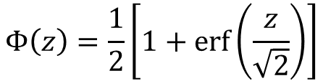
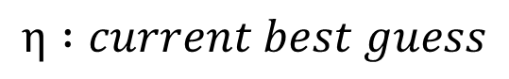
Probability of Improvement
$$η :current best guess$$
$$Φ\left(z\right)=\frac{1}{2}\left[1+erf⁡\left(\frac{z}{\sqrt{2}}\right)\right]$$
: Gaussian Cumulative Density Ft’n

Slide 25
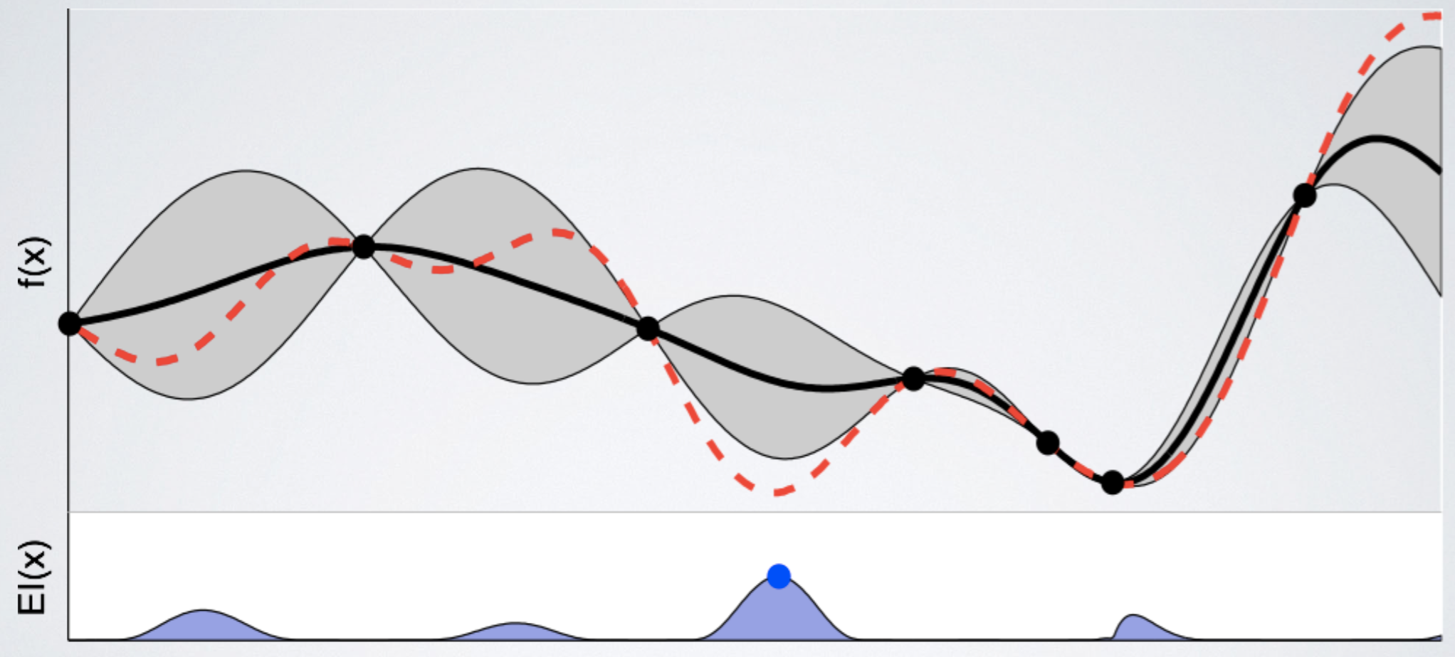

Slide 28
Evolution of an example Gaussian process for three successive
function evaluations (orange dots)
Approximated probability distribution over the location of the
minimum p_{min}(θ) in green

